Slide 1
Exploring H2O.ai Revolutionizing Data Science
Master 1 Artificial Intelligence
Djillali Bounama University

Slide 2

Presented By
ABDELKARIM DOUADJIA
MOHAMED AMINE BOUDJEMAA
Master 1 AI
Master 1 AI

Slide 3
Table of contents
01
03
02
04
Summary of the project goals, methodology, and expected outcomes.
Introduction to H2O.ai
Practical Overview of H2O.ai
Overview of H2O.ai's purpose, features, and significance in data science.
Step-by-step explanation of H2O.ai's workflow and supported algorithms.
Why Choose H2O.ai?
Demo Project Overview
Key benefits and real-world applications of H2O.ai in diverse industries.
Summary of the project goals, methodology, and expected outcomes.

Slide 4
Table of contents
05
07
06
Hands-On Demonstration
Advanced Features of H2O.ai
Live walkthrough showcasing H2O.ai's core functionalities and tools.
Highlighting unique tools like Driverless AI and Explainable AI.
08
Challenges and Solutions
Conclusion
Addressing common issues and how H2O.ai resolves them effectively.
Recap of H2O.ai's benefits and an invitation for audience interaction.

Slide 5
01
Introduction to H2O.ai
Overview of H2O.ai's purpose, features, and significance in data science.

Slide 6

Introduction to H2O.ai
H2O.ai is a cutting-edge platform in the field of data science and machine learning. Known for its open-source framework and user-friendly design, H2O.ai empowers users to solve complex data problems efficiently.
What is H2O.ai?
H2O.ai is a robust AI platform designed to facilitate predictive modeling, data transformation, and AI automation. Its tools are accessible to both novice users and advanced practitioners, offering a versatile solution for diverse data science needs.

Slide 7
Introduction to H2O.ai
Key Characteristics:
Open-source and highly customizable for specific project requirements.
Integrated with popular programming languages like Python, R, and Java.
Scalable for datasets of various sizes, whether on-premises or cloud-based.
Why It Matters
H2O.ai simplifies complex data analysis processes, enabling users to focus on insights and decision-making. By automating repetitive tasks, it accelerates project workflows and reduces development time.

Slide 8
02
Why Choose H2O.ai?
Key benefits and real-world applications of H2O.ai in diverse industries.

Slide 9
Why Choose H2O.ai ?
H2O.ai stands out in the crowded landscape of data science tools due to its unique blend of power and accessibility.
Advantages for Data Scientists:
Automation: The AutoML feature streamlines the creation and optimization of machine learning models, saving time and effort.
Flexibility: It supports a range of machine learning algorithms, from simple regression to advanced deep learning techniques.
Deployment: Models can be seamlessly transitioned from development to production environments.

Slide 10
Why Choose H2O.ai ?
Real-World Applications:
Fraud Detection: H2O.ai analyzes data in real time to identify suspicious activities, protecting businesses from financial losses.
Customer Retention: Predictive models help companies understand and mitigate customer churn.
Financial Applications: It excels in risk analysis and portfolio management, crucial for investment strategies.

Slide 11
03
Practical Overview of H2O.ai
Step-by-step explanation of H2O.ai's workflow and supported algorithms.

Slide 12
Practical Overview of H2O.ai
Understanding how H2O.ai operates is essential for leveraging its full potential, So how H2O.ai works ?
Data Upload
Data Preparation
Model Building
H2O.ai supports multiple file formats, including CSV, Parquet, and Excel, making it highly versatile
Users can clean, merge, and transform data using intuitive tools ensuring readiness for analysis.
Users have the choice of using AutoML for automated processes or building custom models tailored to specific needs

Slide 13
Practical Overview of H2O.ai
Evaluation
Deployment
The platform provides detailed metrics such as accuracy, precision, recall, and AUC for thorough model evaluation.
Once models are finalized, they can be exported and deployed seamlessly across production environments.
Supported Algorithms:
H2O.ai supports a comprehensive range of algorithms, including Linear Regression, Random Forest, Gradient Boosting, and Deep Learning, ensuring adaptability to diverse project requirements.

Slide 14
04
Demo Project Overview
Summary of the project goals, methodology, and expected outcomes.

Slide 15
LIVE Demonstration

Slide 16
05
Hands-On Demonstration
Live walkthrough showcasing H2O.ai's core functionalities and tools.

Slide 17
06
Challenges and Solutions
Addressing common issues and how H2O.ai resolves them effectively.

Slide 18

Challenges and Solutions
Every tool has its challenges, and understanding how to address them is vital for success.
Challenges:
Data quality can significantly impact the results. Inconsistent or missing data poses a challenge.
Overfitting, where models perform well on training data but poorly on new data, is a common issue.
Managing large datasets can be resource-intensive.

Slide 19
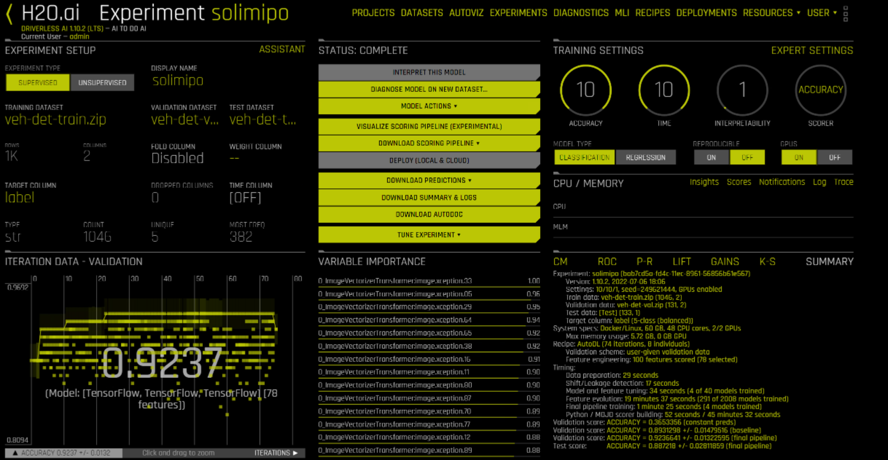
Challenges and Solutions
How H2O.ai Addresses These:
Data quality can significantly impact the results. Inconsistent or missing data poses a challenge.
Overfitting, where models perform well on training data but poorly on new data, is a common issue.
Managing large datasets can be resource-intensive.

Slide 20
07
Advanced Features of H2O.ai
Highlighting unique tools like Driverless AI and Explainable AI.

Slide 21
Advanced Features of H2O.ai
Driverless AI
Explainable AI (XAI)
A premium feature that automates feature engineering and model tuning for enhanced performance.
Built-in tools to interpret model outputs, ensuring transparency in decision-making.
H2O.ai
Integration with Spark
Time-Series Analysis
H2O.ai seamlessly integrates with Apache Spark, allowing users to harness distributed computing for faster and more scalable machine learning tasks.
Specialized algorithms for forecasting and temporal data analysis.

Slide 22
08
Conclusion
Recap of H2O.ai's benefits and an invitation for audience interaction.

Slide 23
Questions & Discussion

Slide 24

Thanks!
Do you have any questions?

